Slide 1

ODataERP
Stefan George, Felix Leupold
Trends and Concepts final presentation

Slide 2
OData Business Context
ODataERP Stack
Performance
Application state
Security/Encryption
OData for HPAs
Ideas for improvement

Slide 3
ODataERP Stack
Client
Server
jQuery.js
App.js
ASP.NET
OData.svc
jQueryUI.js
data.js
MSSQL Server
Stored procedures
DataTables.js

Slide 4
App Screenshot

Slide 5
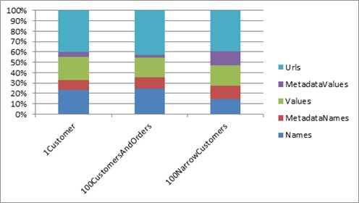
Performance
JSON besser als Atom
JSON Format nicht optimal

Slide 6
Application state
Multiple request per transaction
d

Slide 7
Security/Encryption
DOS Attacken
ODataERP.svc/Customer?$top=100000000$expand=Orders
Authorization (ODataERP.svc):
config.SetEntitySetAccessRule("*", EntitySetRights.All);
No authentication in OData
Authentication on a different layer (e.g. using OAuth)
No role specific authorization on attribute level
[IgnoreProperties(“SecretAttribute")]

Slide 8
HPAs
OData in context of High Performance Applications
Modern HTML5 Webapplications
Most of the code is JavaScript
Using OData for communication
HANA OData Server available
Great for read access
Bad for writing access

Slide 9
Ideas
360/1100 = 32% LOC OData Service Functions
Idea: OData ORM for datajs
Shorter syntax
Easier to express object creation
Explore Service automatically
Easier to read
Issue: datajs is asynchronous only
Using callbacks

Slide 10
Future of OData

Slide 11
Conclusion
OData is great for exposing data for reading access
OData is great for small publishing apps
Notes:
Next Steps
Wie weit ist der Prozess implementiert

